Slide 1
Lecture 19
Topics:
Rules of counting
Sum Rule
Product Rule
Subtraction Rule
The Pigeonhole Principle

Slide 2
6.1 The Basics of Counting
We first present two basic counting principles, the product rule and the sum rule. Then we will show how they can be used to solve many different counting problems.
The product rule applies when a procedure is made up of separate tasks.
THE PRODUCT RULE Suppose that a procedure can be broken down into a sequence of two tasks. If there are n₁ ways to do the first task and for each of these ways of doing the first task, there are n₂ ways to do the second task, then there are n₁ * n₂ ways to do the procedure.

Slide 3
Product Rule Examples:
EXAMPLE 1: A new company with just two employees, Sanchez and Patel, rents a floor of a building with 12 offices. How many ways are there to assign different offices to these two employees?
Solution: The procedure of assigning offices to these two employees consists of assigning an office to Sanchez, which can be done in 12 ways, then assigning an office to Patel different from the office assigned to Sanchez, which can be done in 11 ways.
By the product rule, there are 12 * 11 = 132 ways to assign offices to these two employees.
EXAMPLE 4: How many different bit strings of length seven are there?
Solution: Each of the seven bits can be chosen in two ways, because each bit is either 0 or 1. Therefore, the product rule shows there are a total of 2⁷ = 128 different bit strings of length seven.

Slide 4
THE SUM RULE:
If a task can be done either in one of n₁ ways or in one of n₂ ways, where none of the set of n₁ ways is the same as any of the set of n₂ ways, then there are n₁ + n₂ ways to do the task.
EXAMPLE 13 A student can choose a computer project from one of three lists. The three lists contain 23, 15, and 19 possible projects, respectively. No project is on more than one list. How many possible projects are there to choose from?
Solution: The student can choose a project by selecting a project from the first list, the second list, or the third list. Because no project is on more than one list, by the sum rule there are 23 + 15 + 19 = 57 ways to choose a project.

Slide 5
More Complex Examples:
EXAMPLE 16 Each user on a computer system has a password, which is six to eight characters long, where each character is an uppercase letter or a digit. Each password must contain at least one digit. How many possible passwords are there?
Solution: Let P be the total number of possible passwords, and let P₆, P₇, and P₈ denote the number of possible passwords of length 6, 7, and 8, respectively.
By the sum rule, P = P₆ + P₇ + P₈. We will now find P₆, P₇, and P₈ . Finding P₆ directly is difficult. To find P₆ it is easier to find the number of strings of uppercase letters and digits that are six characters long, including those with no digits, and subtract from this the number of strings with no digits. By the product rule, the number of strings of six characters is 366, and the number of strings with no digits is 266.

Slide 6
P₆ = 366 − 266 = 2,176,782,336 − 308,915,776 = 1,867,866,560.
Similarly, we have
P₇ = 367 − 267 = 78,364,164,096 − 8,031,810,176 = 70,332,353,920
and
P₈ = 368 − 268 = 2,821,109,907,456 − 208,827,064,576
= 2,612,282,842,880.
Consequently,
P = P₆ + P₇ + P₈ = 2,684,483,063,360.

Slide 7
6.1.4 The Subtraction Rule (Inclusion–Exclusion for Two Sets)
If a task can be done in either n1 ways or n2 ways, then the number of ways to do the task is n₁ + n₂ minus the number of ways to do the task that are common to the two different ways.
The subtraction rule is also known as the principle of inclusion–exclusion, especially when it is used to count the number of elements in the union of two sets.

Slide 8
Subtraction Rules:
Suppose that A₁ and A are sets. Then, there are |A₁ | ways to select an element from A₁ and |A₂| ways to select an element from A₂. The number of ways to select an element from A₁ or from A₂, that is, the number of ways to select an element from their union, is the sum of the number of ways to select an element from A₁ and the number of ways to select an element from A₂, minus the number of ways to select an element that is in both A₁ and A₂. Because there are |A₁ ∪ A₂| ways to select an element in either A₁ or in A₂, and |A₁ ∩ A₂| ways to select an element common to both setsm we have |A₁ ∪ A₂| = |A₁| + |A₂| − |A₁ ∩ A₂|

Slide 9
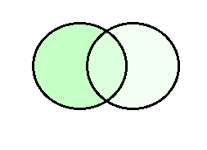
EXAMPLE 19 A computer company receives 350 applications from college graduates for a job planning a line of new web servers. Suppose that 220 of these applicants majored in computer science, 147 majored in business, and 51 majored both in computer science and in business. How many of these applicants majored neither in computer science nor in business?
U
|A₁| = 220
|A₂| = 147
|A₁ ∩ A₂| =51
A₁ ∩ A₂
A₁
A₂

Slide 10
Solution:
To find the number of these applicants who majored neither in computer science nor in business, we can subtract the number of students who majored either in computer science or in business (or both) from the total number of applicants. Let A₁ be the set of students who majored in computer science and A₂ the set of students who majored in business. Then A₁ ∪ A₂ is the set of students who majored in computer science or business (or both), and A₁ ∩ A₂ is the set of students who majored both in computer science and in business. By the subtraction rule
the number of students who majored either in computer science or in business (or both) equals
|A₁ ∪ A₂ | = |A₁ | + |A₂ | − |A₁ ∩ A₂ | = 220 + 147 − 51 = 316.
We conclude that 350 − 316 = 34 of the applicants majored neither in computer science nor in business.

Slide 11
6.2 The Pigeonhole Principle
THEOREM 1 : If k is a positive integer and k + 1 or more objects are placed into k boxes, then there is at least one box containing two or more of the objects.
Proof: We prove the pigeonhole principle using a proof by contraposition. Suppose that none of the k boxes contains more than one object. Then the total number of objects would be at most k. This is a contradiction, because there are at least k + 1 objects.

Slide 12
COROLLARY 1 A function f from a set with k + 1 or more elements to a set with k elements is not one-to-one.
Proof: Suppose that for each element y in the codomain of f we have a box that contains all elements x of the domain of f such that f(x) = y. Because the domain contains k + 1 or more elements and the codomain contains only k elements, the pigeonhole principle tells us that one of these boxes contains two or more elements x of the domain. This means that f cannot be one-to-one.
EXAMPLE 2 In any group of 27 English words, there must be at least two that begin with the same letter, because there are 26 letters in the English alphabet.

Slide 13
EXAMPLE 4 Show that for every integer n there is a multiple of n that has only 0s and 1s in its decimal expansion.
Solution: Let n be a positive integer. Consider the n + 1 integers 1, 11, 111, … , 11 … 1 (where the last integer in this list is the integer with n + 1 1s in its decimal expansion). Note that there are n possible remainders when an integer is divided by n. Because there are n + 1 integers in this list, by the pigeonhole principle there must be two with the same remainder when divided by n. The larger of these integers less the smaller one is a multiple of n, which has a decimal expansion consisting entirely of 0s and 1s.

Slide 14
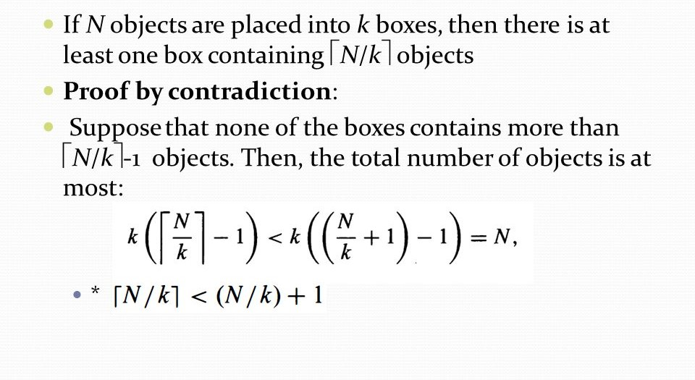
6.2.2 The Generalized Pigeonhole Principle

Slide 15
EXAMPLE 6 What is the minimum number of students required in a discrete mathematics class to be sure that at least six will receive the same grade, if there are five possible grades, A, B, C, D, and F?
Solution: The minimum number of students needed to ensure that at least six students receive Examples the same grade is the smallest integer N such that
⌈N ∕ 5⌉ = 6. The smallest such integer is N = 5 ⋅ 5 + 1 = 26.
If you have only 25 students, it is possible for there to be five who have received each grade so that no six students have received the same grade. Thus, 26 is the minimum number of students needed to ensure that at least six students will receive the same grade.

Slide 16
6.2.3 Some Elegant Applications of the Pigeonhole Principle
EXAMPLE 10 During a month with 30 days, a baseball team plays at least one game a day, but no more than 45 games. Show that there must be a period of some number of consecutive days during which the team must play exactly 14 games.
Solution: Let aj be the number of games played on or before the jth day of the month. Then a₁, a₂, … , a₃₀ is an increasing sequence of distinct positive integers, with 1 ≤ aj ≤ 45. Moreover, a₁ + 14, a₂ + 14, … , a₃₀ + 14 is also an increasing sequence of distinct positive integers, with 15 ≤ a_{j} + 14 ≤ 59. The 60 positive integers a₁, a₂, … , a₃₀, a₁ + 14, a₂ + 14, … , a₃₀ + 14 are all less than or equal to 59. Hence, by the pigeonhole principle two of these integers are equal. Because the integers a_{j}, j = 1, 2, … , 30 are all distinct and the integers a_{j} + 14, j = 1, 2, … , 30 are all distinct, there must be indices i and j with a_{i} = a_{j}+ 14. This means that exactly 14 games were played from day j + 1 to day i.

Slide 17
EXAMPLE 11 Show that among any n + 1 positive integers not exceeding 2n there must be an integer that divides one of the other integers.
Solution: Write each of the n + 1 integers a₁, a₂, … , a_{n+1} as a power of 2 times an odd integer. In other words, let a_{j} = 2a^{k}_{i} q_{j} for j = 1, 2, … , n + 1, where q_{j} is a nonnegative integer and q_{j} is odd. The integers a₁, a₂, … , a_{n+1} are all odd positive integers less than 2n. Because there are only n odd positive integers less than 2n, it follows from the pigeonhole principle that two of the integers a₁, a₂, … , a_{n+1} must be equal. Therefore, there are distinct integers i and j such that q_{i} =q_{j} . Let q be the common value of a_{i} and a_{j}. Then, a_{i} = 2^{k}_{i}q and a_{j} = 2^{k}_{j}q.
It follows that if k_{i} < k_{j} , then a_{i} divides a_{j} ; while if k_{i} > k_{j} , then a_{j} divides a_{i} .

Slide 18
Self Study
THEOREM 3: Every sequence of n² + 1 distinct real numbers contains a subsequence of length n + 1 that is either strictly increasing or strictly decreasing. We give an example before presenting the proof of Theorem 3.
EXAMPLE 12 The sequence 8, 11, 9, 1, 4, 6, 12, 10, 5, 7 contains 10 terms. Note that 10 = 3² + 1. There are four strictly increasing subsequences of length four, namely, 1, 4, 6, 12; 1, 4, 6, 7; 1, 4, 6, 10; and 1, 4, 5, 7. There is also a strictly decreasing subsequence of length four, namely, 11, 9, 6, 5.

Slide 19
Self Study
Proof: Let a₁, a₂, … , a_{n2+1} be a sequence of n² + 1 distinct real numbers. Associate an ordered pair with each term of the sequence, namely, associate (i_{k}, d_{k}) to the term a_{k}, where i_{k} is the length of the longest increasing subsequence starting at a_{k}, and d_{k} is the length of the longest decreasing subsequence starting at a_{k}. Suppose that there are no increasing or decreasing subsequences of length n + 1. Then i_{k} and d_{k} are both positive integers less than or equal to n, for k = 1, 2, … , n² + 1. Hence, by the product rule there are n² possible ordered pairs for ( i_{k}, d_{k}). By the pigeonhole principle, two of these n² + 1 ordered pairs are equal. In other words, there exist terms as and at, with s < t such that i_{s} = i_{t} and d_{s} = d_{t}. We will show that this is impossible. Because the terms of the sequence are distinct, either a_{s} < a_{t} or a_{s} > a_{t}. If a_{s} < a_{t}, then, because i_{s} = i_{t} , an increasing subsequence of length i_{t}+ 1 can be built starting at a_{s} , by taking as followed by an increasing subsequence of length it beginning at a_{t}. This is a contradiction. Similarly, if a_{s} > a_{t}, the same reasoning shows that d_{s} must be greater than d_{t}, which is a contradiction.

Slide 20
Self Study
The final example shows how the generalized pigeonhole principle can be applied to an important part of combinatorics called Ramsey theory, after the English mathematician F. P. Ramsey. In general, Ramsey theory deals with the distribution of subsets of elements of sets.
EXAMPLE 13 Assume that in a group of six people, each pair of individuals consists of two friends or two enemies. Show that there are either three mutual friends or three mutual enemies in the group.
Solution: Let A be one of the six people. Of the five other people in the group, there are either three or more who are friends of A, or three or more who are enemies of A. This follows from:

Slide 21
Self Study
The generalized pigeonhole principle, because when five objects are divided into two sets, one of the sets has at least ⌈5∕2⌉ = 3 elements. In the former case, suppose that B, C, and D are friends of A. If any two of these three individuals are friends, then these two and A form a group of three mutual friends. Otherwise, B, C, and D form a set of three mutual enemies. The proof in the latter case, when there are three or more enemies of A, proceeds in a similar manner.
The Ramsey number R(m, n), where m and n are positive integers greater than or equal to 2, denotes the minimum number of people at a party such that there are either m mutual friends or n mutual enemies, assuming that every pair of people at the party are friends or enemies. Example 13 shows that R(3, 3) ≤ 6. We conclude that R(3, 3) = 6 because in a group of five people where every two people are friends or enemies, there may not be three mutual friends or three mutual enemies (see Exercise 28 from the book).

Slide 22
Self Study
It is possible to prove some useful properties about Ramsey numbers, but for the most part it is difficult to find their exact values. Note that by symmetry it can be shown that R(m, n) = R(n, m) (see Exercise 32). We also have R(2, n) = n for every positive integer n ≥ 2 (see Exercise 31). The exact values of only nine Ramsey numbers R(m, n) with 3 ≤ m ≤ n are known, including R(4, 4) = 18.
Only bounds are known for many other Ramsey numbers, including R(5, 5), which is known to satisfy 43 ≤ R(5, 5) ≤ 49. The reader interested in learning more about Ramsey numbers should consult [MiRo91] or [GrRoSp90].

Slide 23
The end

